Slide 1
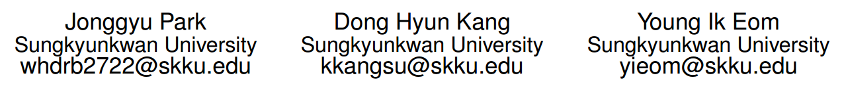
File Defragmentation Scheme for a Log-Structured File System

Slide 2
File Defragmentation Scheme for a Log-Structured File System
Tested Hardware Platform
SD card1:16GB Kingston
SD card2:16GB Sandisk
SSD:120GB Intel SSD
all are partitioned
How to creat file fragmentation?
create several files using synchronous writes from IOzone with 8 threads
delete several files to create victim segments
create several dump files to trigger the cleaning process

Slide 3

Improving File System Performance of Mobile Storage Systems Using a Decoupled Defragmenter
Sungjin Lee：https://www.researchgate.net/profile/Sungjin_Lee6

Slide 4
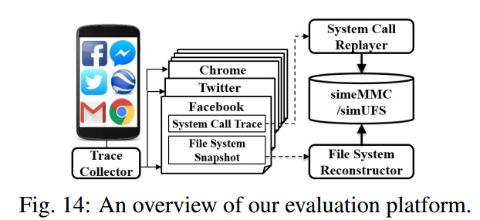
Improving File System Performance of Mobile Storage Systems Using a Decoupled Defragmenter
It's impossible to modify mobile storage devices and smartphone platforms:
build two emulated mobile flash devices, called simeMMC and simUFS
use a customizable SSD device based on Samsung’s 843T SSD
843T SSD supports extended SATA interfaces that allow a host system to directly control channels using NAND-specific I/O primitives → implement a complete page-level FTL in a block layer
emulate I/O throughputs of eMMC and UFS by limiting the number of available channels of the 843T SSD to 4 and 8 for simeMMC and simUFS
increase end-to-end I/O latencies between the host and the flash device → simulate a smaller I/O queue depth of mobile storage
implement a comprehensive evaluation platform
the evaluation platform supports three useful features:
1.file-system snapshot/replication
2.trace collection/replay
3.mobile storage emulation

Slide 5
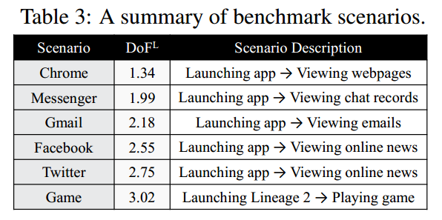
Improving File System Performance of Mobile Storage Systems Using a Decoupled Defragmenter
janusd
implement janusdL/P as a user-level tool using e4defrag
janusdFTL is implemented as an extended module of the page-level FTL in the block layer
The custom interfaces between janusdL/janusdP and janusdFTL are implemented using the ioctl facility of the Linux
Usage Scenario of Smartphone
collect I/O activities of six popular applications running on N6
create a six-month usage scenario of a smartphone：
1.simulate a daily usage scenario of a smartphone by repeating the six scenarios for
220 minutes
2. create a six-month usage scenario by repeating the daily usage scenario 180 times

Slide 6
DFS: A De-fragmented File System

Slide 7
DFS: A De-fragmented File System
Tested Hardware Platform
PC with a 700 MHz Pentium processor and 128 MB of main memory.
The disk on the system is a Quantum Fireball EX.
OpenBSD operating system version 2.8.

Slide 8
DFS: A De-fragmented File System
How to creat file fragmentation?
(as the fragmentation shown in previous research)
executes sequences of file system operations
file creates and deletes are actively applied to our testing file systems to simulate the effects of a long period of use
each create operation performs not only creation of a file, but also writing of data

Slide 9
Suspend-aware Segment Cleaning in Log-structured File System

Slide 10
Suspend-aware Segment Cleaning in Log-structured File System
Tested Hardware Platform
Motorola Moto G (Android 4.4.2, Linux Kernel 3.4)
F2FS
2 experiments
the number of reclaimed segments under Suspend-aware Segment Cleaning
the effectiveness of the Utilization-based Segment Cleaning

Slide 11
Suspend-aware Segment Cleaning in Log-structured File System
the number of reclaimed segments
three situations: 1.Suspend-aware Segment Cleaning with suspend-mode on
2.Stock segment cleaning with suspend mode on
3.Stock segment cleaning with suspend mode off
Segment cleaning in F2FS is activated in 30 - 60 sec. interval, and it reclaims one segment on each segment cleaning.
the effectiveness of the Utilization-based Segment Cleaning
vary the file system utilization(u = 30, 50, 70, 90%) and fraction of invalid blocks in the file system partition (pinv = 25;50;70%)
put the device to suspend mode 50 times and count the total number of reclaimed segments

Slide 12
Boosting Quasi-Asynchronous I/O for Better Responsiveness in Mobile Devices
Daeho Jeong:daeho.jeong@samsung.com

Slide 13
Boosting Quasi-Asynchronous I/O for Better Responsiveness in Mobile Devices
Tested Hardware Platform
Samsung Galaxy S5, equipped with Exynos 5422 (including quad Cortex-A15 and quad Cortex-A7 ARM CPUs and Mali-T628 MP6 GPU), 2GB DRAM, and 16GB eMMC flash storage.
Android platform version 4.4.2 (KitKat), with the Linux kernel 3.10.9.
Defaulted dirty page expiration time:2 seconds
defaulted background dirty ratio:5%
5 microbenchmarks/3 real-life scenarios/2 I/O benchmarks for Android
2 I/O benchmarks for Android
Antutu:a comprehensive Android benchmark which provides several modes for measuring the performance of CPU, memory, storage system, etc.
RLBench:a benchmark for measuring the performance of Android devices under SQLite workloads.

Slide 14
Boosting Quasi-Asynchronous I/O for Better Responsiveness in Mobile Devices
5 microbenchmarks
M1:M1 iterates the creation of a 4KB file 500 times.
creat()/buffered write()/fsync()/close()
M2:M2 iterates the creation of a 1MB file 200 times.
creat()/write() system call/fsync()/close()
M3: M3 creates a new file and repeats a 1KB-sized write() until the file size reaches 300MB.
creat()/write()
M4:M4 iterates 500 times. In each iteration:
1.truncates the 2MB file created in the previous iteration to zero length
2.recreates the same sized file
truncate()/write()/close()
M5: 1.one task creates a single 4KB file
2.another task truncates an existing 8GB file and writes 8GB data to the file
1.creat()/write()/fsync()/close() 2.truncate()/write()

Slide 15
Boosting Quasi-Asynchronous I/O for Better Responsiveness in Mobile Devices
Methodology
run all the microbenchmarks except M5 while a 8GB file is written in the background in order to generate asynchronous I/O operations
use above 5 microbenchmarks to investigate the impact of QASIOs on the latency of various file system operations
the proposed scheme is evaluated with 3 real-life scenarios,2 representative I/O benchmarks in Android and 5 microbenchmarks

Slide 16
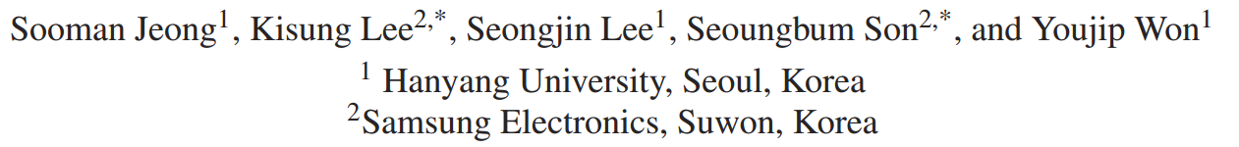
I/O stack optimization for smartphones
Seongjin Lee：https://www.researchgate.net/profile/Seongjin_Lee

Slide 17
I/O stack optimization for smartphones
study of Android I/O characterization
Galaxy S3 (Samsung Exynos 4412 1.4 GHz Quadcore, 2 GB RAM, 32 GB eMMC, Android 4.0.4 with Linux kernel 3.0.15)
use MOST (Mobile Storage Analyzer) to collect and analyze the I/O trace
analyze the I/O behavior of Facebook and Twitter apps
verify the effectiveness of the optimization
examine the performance of each optimization technique under a real workload
collect the system call trace and then replayed it with Mobigen
capture traces from two widely used Android applications: Twitter and Facebook

Slide 18
I/O stack optimization for smartphones
Combining All the Improvements
4 optimization technique:1.Eliminating Unnecessary Metadata Flushes
2.Using the Optimal Journaling Mode in SQL
3.External Journaling 4.Polling-based I/O
External Journaling is not applicable to F2FS since it is a log-structured filesystem
examine the SQLite performance on three filesystems (EXT4 as the baseline, XFS, and F2FS) when applying the aforementioned three techniques in combination.
SQLite journaling mode was set to TRUNCATE (default).

